Slide 1
Estimation of Actuation Configuration for a Multi-Actuated Blimp
Final Presentation (Semester Thesis)
Students: Matthias Krebs Advisors: Kostas Alexis
Simon Laube Markus Achtelik

Slide 2
Content
Motivation
System Overview
Problem Formulation
Parameters
System Model
Input Pattern
Optimization
Results
Simulation Results
Experimental Results
Ground Truth
Conclusion & Outlook

Slide 3
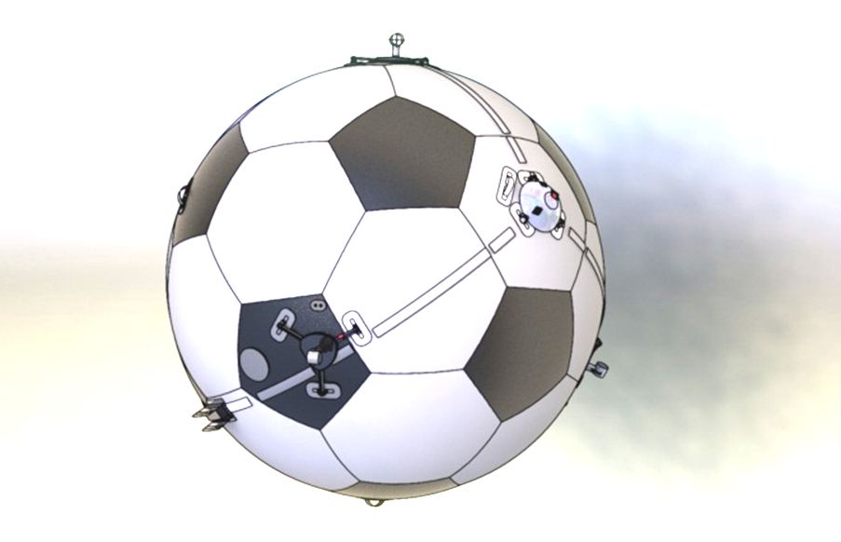
Motivation
FANCY SLIDE
Parameters

Slide 4
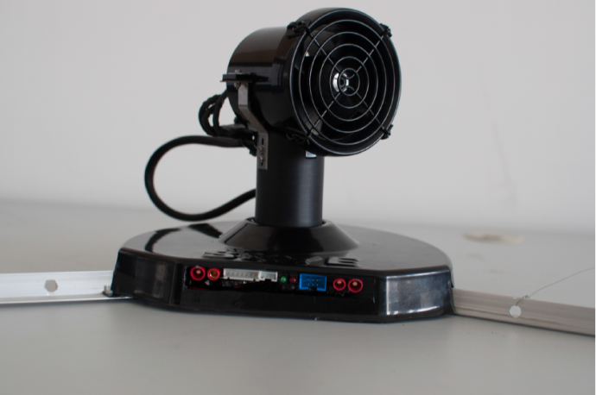
System Overview
Spherical Hull filled with Helium
4 Actuation Units (AU)
Electronics:
IMU
Controller
XBee
Rotation
Thrust

Slide 5
System Overview

Slide 6
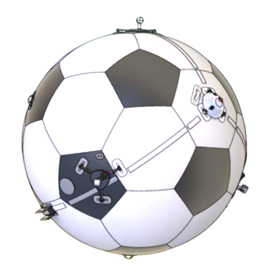
System Overview
Controller
System
Controller
Allocation
Actuation
Body Dynamics
3
4
3
4
4
Setpoint
F_{Blimp}
F_{Motors}
F_{Motors}
3
4
3
4
4
M_{Blimp}
α_{Motors}
α_{Motors}
4
Encoder
State Estimation

Slide 7
Goals

Slide 8
Problem Formulation
IMU Data
Actuator Input Pattern .
Parameter
Optimization Algorithm
Model
Model Output

Slide 9

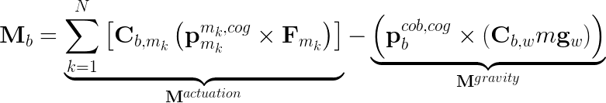
Problem Formulation: System Model
Angular Acceleration
Neglect aerodynamic effects on rotation

Slide 10
Problem Formulation: Parameters
Actuator Arrangement
Actuator Arrangement
Actuator Arrangement
Actuator Arrangement
Orientation SO(3)
Center of Gravity R³
Mass R
Position R³
Inertia Tensor Sym(3)
Radius
R
e.g. Drag Torque is another jointly observable param
Full Parameter set is only jointly observable

Slide 11
Problem Formulation: Parameters
Actuator Arrangement
Actuator Arrangement
Actuator Arrangement
Actuator Arrangement
Orientation SO(3)
Center of Gravity R³
Mass R
Position R³
Inertia Tensor Sym(3)
Radius
R
Position is assumed to be on sphere
Radius and mass are fixed (they don‘t influence result)

Slide 12
Problem Formulation: System Model
Angular Acceleration
Assume perfect knowledge of actuator force (in steady state)

Slide 13
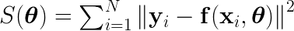

Problem Formulation: Optimization
Nonlinear Least Squares
Levenberg-Marquardt
Robust and fast gradient based minimization

Slide 14
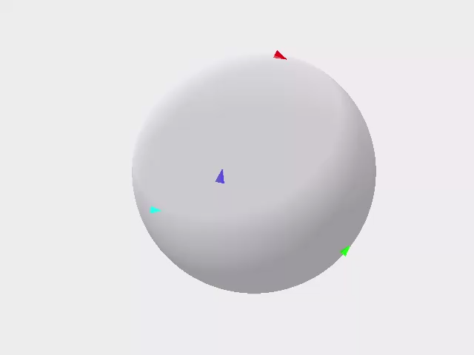
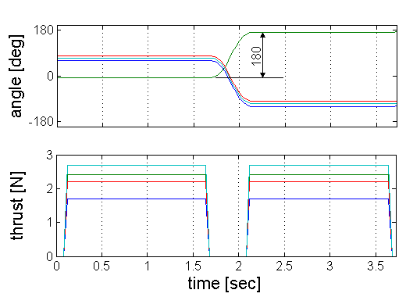
Problem Formulation: Input Pattern
Inputs must be applicable and sufficiently excited
Apply sequence of forward/backward force patterns in varying directions for all actuation units
Steady state motor dynamics

Slide 15
Simulator

Slide 16
Results
Simulation Results
Confidence Region
Convergence Region
Casestudies (no drag; 1AU; 5AU; COG offset;)
Experimental Results
Groundtruth with Leica

Slide 17
Simulation: Confidence Region
Zeige Konvergenz & Anzahl Iterationen mit LMA

Slide 18
Simulation: Casestudies
mean | AU4 x | AU4 y | J | cog
Default | 6.18e-04 | 7.66e-04 | 6.12e-02 | 6.94e-05
No drag | -4.89e-04 | 1.38e-03 | 5.16e-02 | 1.81e-05
Resnorm [rad/s2]
6.73e-04
6.88e-04
std | AU4 x | AU4 y | J | cog
Default | 3.65e-03 | 7.19e-03 | 3.00e-02 | 1.35e-04
No drag | 4.29e-03 | 7.96e-03 | 3.35e-02 | 1.21e-04
32 simulations à 2000 raw datapoints

Slide 19
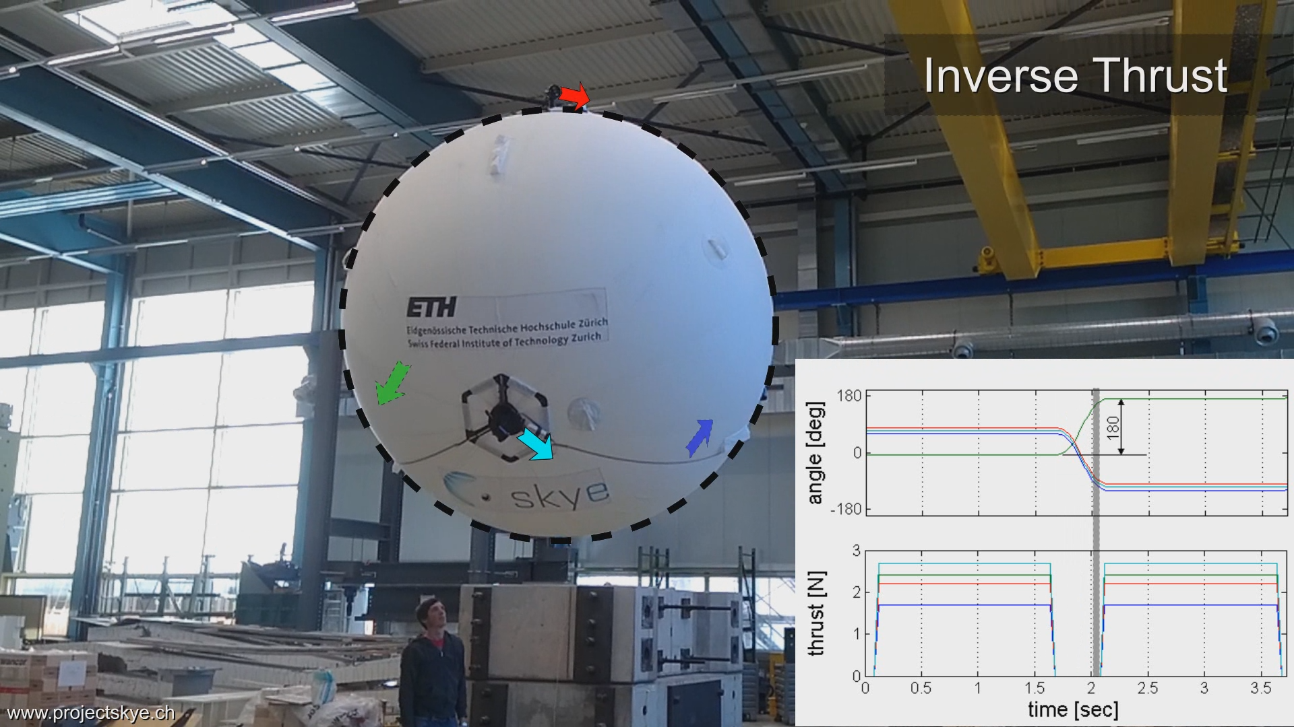

Problem Formulation: Input Pattern

Slide 20
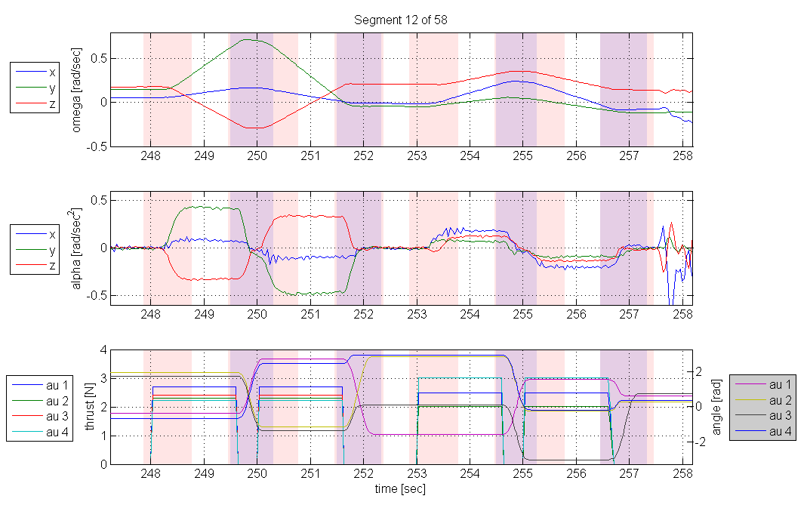
Data Acquisition (Preprocessing)
Start Transient
Stop Transient
Disturbance:
Remove manually
ZOOM

Slide 21
Results: Experiments

Slide 22
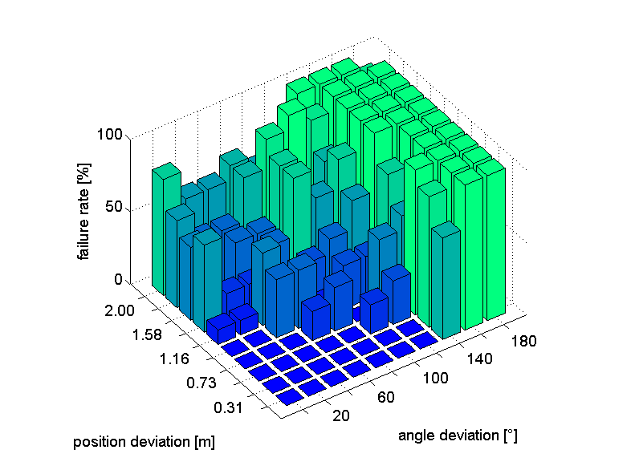
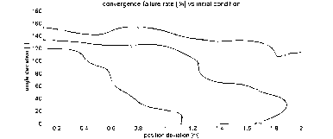
Simulation: Convergence Region
Initial Parameters can be about 1m or 120° apart of the true value

Slide 23
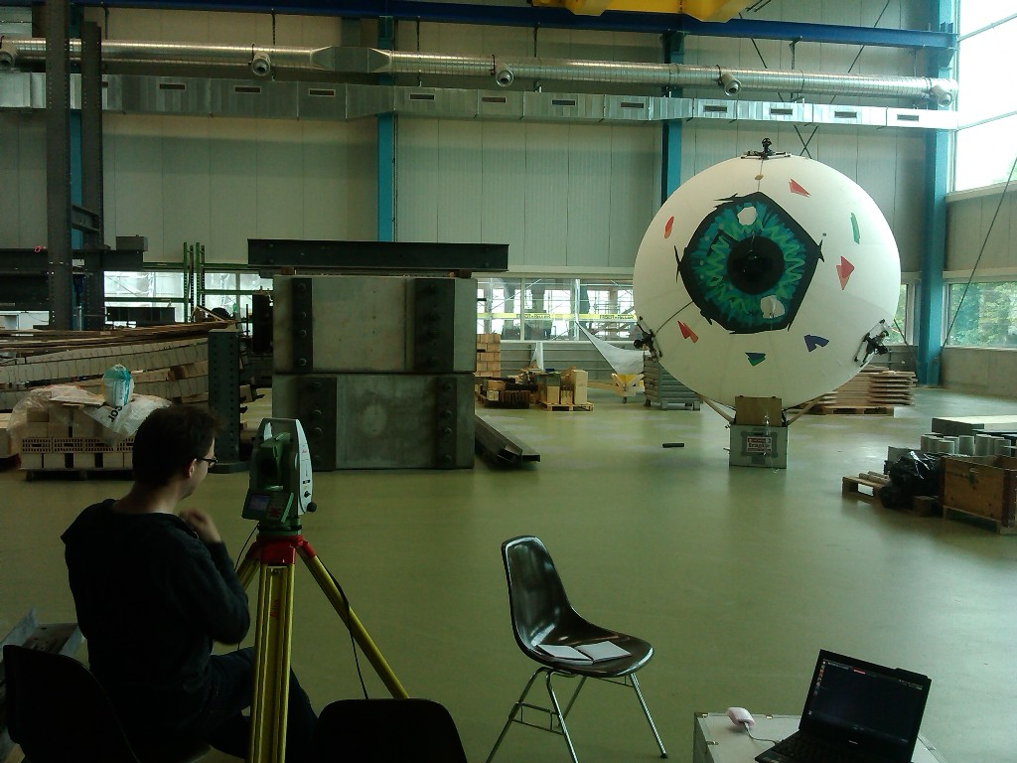
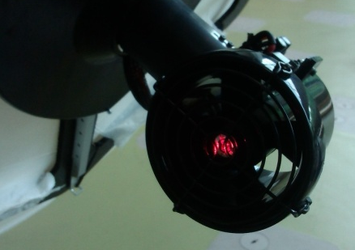
Results: „Ground Truth“ (Leica)
3 AU‘s visible at once
Use different views
Fit data to get tetrahedral‘s edge length
Residual below 0.01m

Slide 24
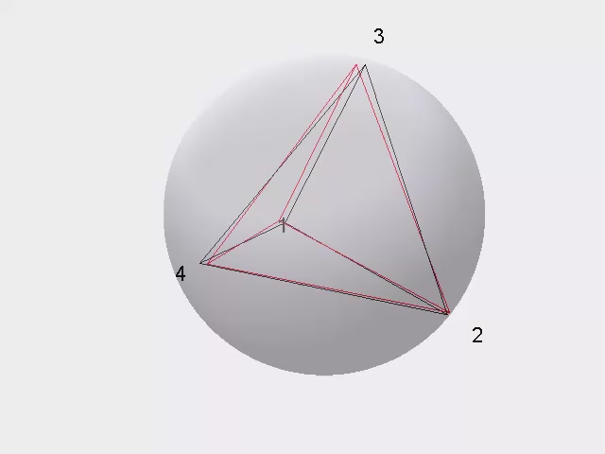
Results: Compare Leica and Batch Solution
Compare tetrahedral edge length
Relative error of batch solution
% | AU2 | AU3 | AU4
AU1 | 1.68 | 0.86 | 2.76
AU2 |  | 0.67 | 2.47
AU3 |  |  | 3.78
Leica
Batch

Slide 25
Discussion

Slide 26
Outlook

